Slide 1
Language fundamentals

Slide 2
Agenda
4. Data types
o Integral data types
▪ Byte
▪ Short
▪ Int
▪ long
o Floating Point Data types
o boolean data type
o Char data type
o Java is pure object oriented programming or not ?
o Summary of java primitive data type
5. Literals
o Integral Literals
o Floating Point Literals
o Boolean literals
o Char literals
o String literals
o 1.7 Version enhansements with respect to Literals
▪ Binary Literals
▪ Usage of _ (underscore)symbol in numeric literals
1. Introduction
2. Identifiers
o Rules to define java identifiers:
3. Reserved words
o Reserved words for data types: (8)
o Reserved words for flow control:(11)
o Keywords for modifiers:(11)
o Keywords for exception handling:(6)
o Class related keywords:(6)
o Object related keywords:(4)
o Void return type keyword
o Unused keywords
o Reserved literals
o Enum
o Conclusions

Slide 3
6. Arrays
1. Introduction
2. Array declaration
▪ Single dimensional array declaration
▪ Two dimensional array declaration
▪ Three dimensional array declaration
3. Array construction
▪ Multi dimensional array creation
4. Array initialization
5. Array declaration, construction, initialization in a single line.
6. length Vs length() method
7. Anonymous arrays
8. Array element assignments
9. Array variable assignments
Types of variables
o Primitive variables
o Reference variables
o Instance variables
o Static variables
o Local variables
o Conclusions
Un initialized arrays
o Instance level
o Static level
o Local level
Var arg method
o Single Dimensional Array Vs Var-Arg Method
Main method
o 1.7 Version Enhansements with respect to main()
Command line arguments
Java coding standards
o Coding standards for classes
o Coding standards for interfaces
o Coding standards for methods
o Coding standards for variables
o Coding standards for constants
o Java bean coding standards
▪ Syntax for setter method
▪ Syntax for getter method
o Coding standards for listeners
▪ To register a listener
▪ To unregister a listener
Various Memory areas present inside JVM

Slide 4

Identifier

Slide 5
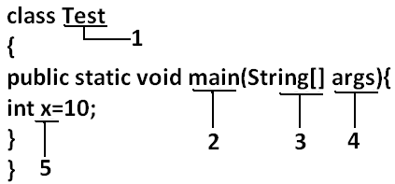
A name in java program is called identifier. It may be class name, method name, variable name and label name.

Slide 6
Rules to define java identifiers
Rule 1: The only allowed characters in java identifiers are:
1) a to z
2) A to Z
3) 0 to 9
4) _ (underscore)
5) $
Rule 2: If we are using any other character we will get compile time error.
Example:
1) total_number-------valid
2) Total#------------------invalid
Rule 3: identifiers are not allowed to starts with digit.
Example:
1) ABC123---------valid
2) 123ABC---------invalid
Rule 4: java identifiers are case sensitive up course java language itself treated as case
sensitive language.
Example:
class Test{
int number=10;
int Number=20;
int NUMBER=20; we can differentiate with case.
int NuMbEr=30;
}
Rule 5: There is no length limit for java identifiers but it is not recommended to take
more than 15 lengths.
Rule 6: We can't use reserved words as identifiers.
Example:
int if=10; --------------invalid
4

Slide 7
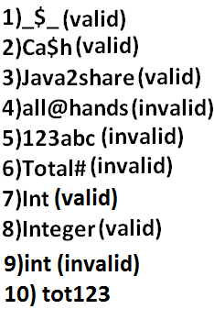
Rule 7: All predefined java class names and interface names we use as identifiers.
Example 1:
class Test
{
public static void main(String[] args){
int String=10;
System.out.println(String);
}}
Output:
10
Example 2:
class Test
{
public static void main(String[] args){
int Runnable=10;
System.out.println(Runnable);
}}
Output:
10
Even though it is legal to use class names and interface names as identifiers but it is not
a good programming practice.
Which of the following are valid java identifiers?
5

Slide 8
Reserved words

Slide 9
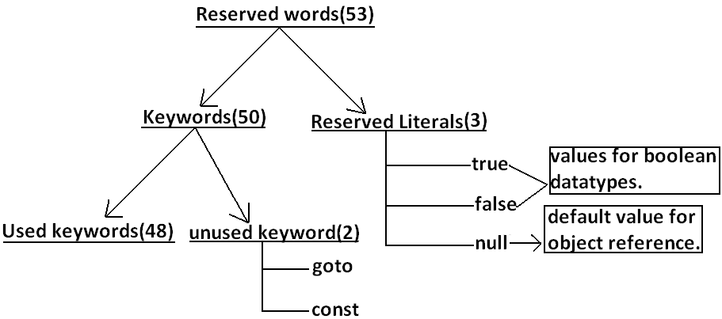
In java some identifiers are reserved to associate some functionality or meaning such type of reserved identifiers are called reserved words
Reserved words for data types: (8)
1) byte
2) short
3) int
4) long
5) float
6) double
7) char
8) boolean
Reserved words for flow control:(11)
1) if
2) else
3) switch
4) case
5) default
6) for
7) do
8) while
9) break
10) continue
11) return
6

Slide 10
Class related keywords:(6)
1) class
2) package
3) import
4) extends
5) implements
6) interface
Object related keywords:(4)
1) new
2) instanceof
3) super
4) this
Void return type keyword:
If a method won't return anything compulsory that method should be declared with the
void return type in java but it is optional in C++.
1) void
Unused keywords:
goto: Create several problems in old languages and hence it is banned in java.
Const: Use final instead of this.
By mistake if we are using these keywords in our program we will get compile time
error.
Keywords for modifiers:(11)
1) public
2) private
3) protected
4) static
5) final
6) abstract
7) synchronized
8) native
9) strictfp(1.2 version)
10) transient
11) Volatile
Keywords for exception handling:(6)
1) try
2) catch
3) finally
4) throw
5) throws
6) assert(1.4 version)

Slide 11
Conclusions :
1. All reserved words in java contain only lowercase alphabet symbols.
2. New keywords in java are:
3. strictfp-----------1.2v
4. assert-------------1.4v
5. enum--------------1.5v
6. In java we have only new keyword but not delete because destruction of useless
objects is the responsibility of Garbage Collection.
7. instanceof but not instanceOf
8. strictfp but not strictFp
9. const but not Constant
10. syncronized but not syncronize
11. extends but not extend
12. implements but not implement
13. import but not imports
14. int but not Int.
Reserved literals:
1) true values for boolean data type.
2) false
3) null----------------- default value for object reference.
Enum:
This keyword introduced in 1.5v to define a group of named constants
Example:
enum Beer
{
KF, RC, KO, FO;
}.

Slide 12
Which of the following list contains only java reserved words ?
1. final, finally, finalize (invalid) //here finalize is a method in Object class.
2. throw, throws, thrown(invalid) //thrown is not available in java
3. break, continue, return, exit(invalid) //exit is not reserved keyword
4. goto, constant(invalid) //here constant is not reserved keyword
5. byte, short, Integer, long(invalid) //here Integer is a wrapper class
6. extends, implements, imports(invalid) //imports keyword is not available in java
7. finalize, synchronized(invalid) //finalize is a method in Object class
8. instanceof, sizeOf(invalid) //sizeOf is not reserved keyword
9. new, delete(invalid) //delete is not a keyword
10. None of the above(valid)
Which of the following are valid java keywords?
1. public(valid)
2. static(valid)
3. void(valid)
4. main(invalid)
5. String(invalid)
6. args(invalid)

Slide 13

Data types

Slide 14
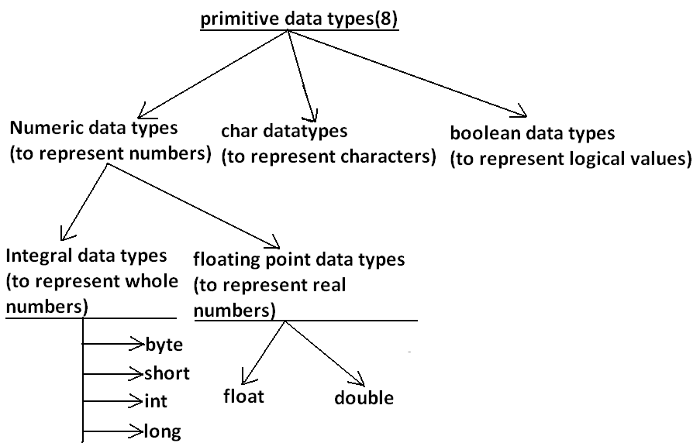
Every variable has a type, every expression has a type and all types are strictly define
more over every assignment should be checked by the compiler by the type
compatibility hence java language is considered as strongly typed programming
language.
Java is pure object oriented programming or not?
Java is not considered as pure object oriented programming language because several
oops features (like multiple inheritance, operator overloading) are not supported by
java moreover we are depending on primitive data types which are non objects.
9

Slide 15
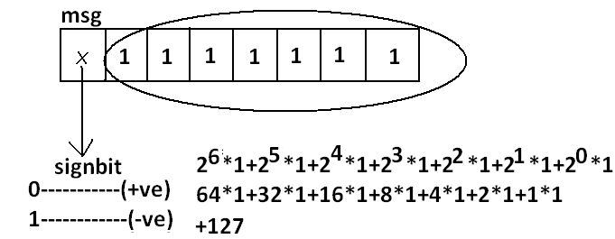
Except Boolean and char all remaining data types are considered as signed data types
because we can represent both "+ve" and"-ve" numbers.
Integral data types :
Byte:
Size: 1byte (8bits)
Maxvalue: +127
Minvalue:-128
Range:-128to 127[-27 to 27-1]

Slide 16
• The most significant bit acts as sign bit. "0" means "+ve" number and "1"
means "–ve" number.
• "+ve" numbers will be represented directly in the memory whereas "–ve"
numbers will be represented in 2's complement form.
Example:
byte b=10;
byte b2=130;//C.E:possible loss of precision
found : int
required : byte
byte b=10.5;//C.E:possible loss of precision
byte b=true;//C.E:incompatible types
byte b="ashok";//C.E:incompatible types
found : java.lang.String
required : byte
byte data type is best suitable if we are handling data in terms of streams either from
the file or from the network.

Slide 17
Short:
The most rarely used data type in java is short.
Size: 2 bytes
Range: -32768 to 32767(-215 to 215-1)
Example:
short s=130;
short s=32768;//C.E:possible loss of precision
short s=true;//C.E:incompatible types
Short data type is best suitable for 16 bit processors like 8086 but these processors are
completely outdated and hence the corresponding short data type is also out data type.
int:
This is most commonly used data type in java.
Size: 4 bytes
Range:-2147483648 to 2147483647 (-231 to 231-1)
Example:
int i=130;
int i=10.5;//C.E:possible loss of precision
int i=true;//C.E:incompatible types

Slide 18
long:
Whenever int is not enough to hold big values then we should go for long data type.
Example:
To hold the no. Of characters present in a big file int may not enough hence the return
type of length() method is long.
long l=f.length();//f is a file
Size: 8 bytes
Range:-263 to 263-1
Note: All the above data types (byte, short, int and long) can be used to represent whole
numbers. If we want to represent real numbers then we should go for floating point
data types.

Slide 19
Floating Point Data types:
Float | double
If we want 5 to 6 decimal places of accuracy then we should go for float. | If we want to 14 to 15 decimal places of accuracy then we should go for double.
Size:4 bytes. | Size:8 bytes
Range:-3.4e38 to 3.4e38. | -1.7e308 to1.7e308.
float follows single precision | double follows double precision.

Slide 20
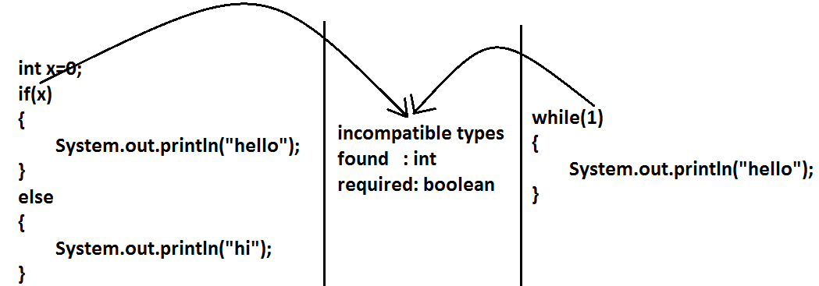
Example 2:
boolean data type:
Size: Not applicable (virtual machine dependent)
Range: Not applicable but allowed values are true or false.
Which of the following boolean declarations are valid?
Example 1:
boolean b=true;
boolean b=True;//C.E:cannot find symbol
boolean b="True";//C.E:incompatible types
boolean b=0;//C.E:incompatible types

Slide 21
Char data type:
In old languages like C & C++ are ASCII code based the no.Of ASCII code characters
are < 256. To represent these 256 characters 8 - bits enough hence char size in old
languages 1 byte.
In java we are allowed to use any worldwide alphabets character and java is Unicode
based and no.Of unicode characters are > 256 and <= 65536 to represent all these
characters one byte is not enough compulsory we should go for 2 bytes.
Size: 2 bytes
Range: 0 to 65535
Example:
char ch1=97;
char ch2=65536;//C.E:possible loss of precision

Slide 22
Summary of java primitive data type:
The default value for the object references is "null".
data type | Size | Range | Corresponding Wrapper class | Default value
byte | 1 byte | -27 to 27-1(-128 to 127) | Byte | 0
short | 2 bytes | -215 to 215-1 (-32768 to32767) | Short | 0
int | 4 bytes | -231 to 231-1 (-2147483648 to 2147483647) | Integer | 0
long | 8bytes | -263 to 263-1 | Long | 0
float | 4bytes | -3.4e38 to 3.4e38 | Float | 0.0
double | 8bytes | -1.7e308 to 1.7e308 | Double | 0.0
boolean | Not applicable | Not applicable(but allowed values true|false) | Boolean | false
char | 2 bytes | 0 to 65535 | Character | 0(represents blank space)

Slide 23
Literals

Slide 24
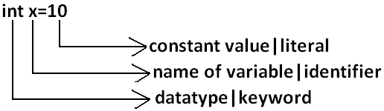
Any constant value which can be assigned to the variable is called literal.
Example
Integral Literals:
For the integral data types (byte, short, int and long) we can specify literal value in the
following ways.
1) Decimal literals: Allowed digits are 0 to 9.
Example: int x=10;
2) Octal literals: Allowed digits are 0 to 7. Literal value should be prefixed with zero.
Example: int x=010;

Slide 25
Hexa Decimal literals:
• The allowed digits are 0 to 9, A to Z.
• For the extra digits we can use both upper case and lower case characters.
• This is one of very few areas where java is not case sensitive.
• Literal value should be prefixed with ox(or)oX.
Example: int x=0x10;
These are the only possible ways to specify integral literal.
Which of the following are valid declarations?
1. int x=0777; //(valid)
2. int x=0786; //C.E:integer number too large: 0786(invalid)
3. int x=0xFACE; (valid)
4. int x=0xbeef; (valid)
5. int x=0xBeer; //C.E:';' expected(invalid) //:int x=0xBeer; ^// ^
6. int x=0xabb2cd;(valid)

Slide 26
Example:
int x=10;
int y=010;
int z=0x10;
System.out.println(x+"----"+y+"----"+z); //10----8----16
By default every integral literal is int type but we can specify explicitly as long type by
suffixing with small "l" (or) capital "L".
Example:
int x=10;(valid)
long l=10L;(valid)
long l=10;(valid)
int x=10l;//C.E:possible loss of precision(invalid)
found : long
required : int

Slide 27
There is no direct way to specify byte and short literals explicitly. But whenever we are
assigning integral literal to the byte variables and its value within the range of byte
compiler automatically treats as byte literal. Similarly short literal also.
Example:
byte b=127;(valid)
byte b=130;//C.E:possible loss of precision(invalid)
short s=32767;(valid)
short s=32768;//C.E:possible loss of precision(invalid)
Floating Point Literals:
Floating point literal is by default double type but we can specify explicitly as float type
by suffixing with f or F.
Example:
float f=123.456;//C.E:possible loss of precision(invalid)
float f=123.456f;(valid)
double d=123.456;(valid)
We can specify explicitly floating point literal as double type by suffixing with d or D.

Slide 28
Example:
double d=123.456D;
We can specify floating point literal only in decimal form and we can't specify in octal
and hexadecimal forms.
Example:
double d=123.456;(valid)
double d=0123.456;(valid) //it is treated as decimal value but not octal
double d=0x123.456;//C.E:malformed floating point literal(invalid)
Which of the following floating point declarations are valid?
1. float f=123.456; //C.E:possible loss of precision(invalid)
2. float f=123.456D; //C.E:possible loss of precision(invalid)
3. double d=0x123.456; //C.E:malformed floating point literal(invalid)
4. double d=0xFace; (valid)
5. double d=0xBeef; (valid)

Slide 29
We can assign integral literal directly to the floating point data types and that integral
literal can be specified in decimal , octal and Hexa decimal form also.
Example:
double d=0xBeef;
System.out.println(d);//48879.0
But we can't assign floating point literal directly to the integral types.
Example:
int x=10.0;//C.E:possible loss of precision
We can specify floating point literal even in exponential form also(significant notation).
Example:
double d=10e2;//==>10*102(valid)
System.out.println(d);//1000.0
float f=10e2;//C.E:possible loss of precision(invalid)
float f=10e2F;(valid)

Slide 30
Boolean literals:
The only allowed values for the boolean type are true (or) false where case is important.
i.e., lower case
Example:
1. boolean b=true;(valid)
2. boolean b=0;//C.E:incompatible types(invalid)
3. boolean b=True;//C.E:cannot find symbol(invalid)
4. boolean b="true";//C.E:incompatible types(invalid)

Slide 31
Char literals:
A char literal can be represented as single character within single quotes.
Example:
1. char ch='a';(valid)
2. char ch=a;//C.E:cannot find symbol(invalid)
3. char ch="a";//C.E:incompatible types(invalid)
4. char ch='ab';//C.E:unclosed character literal(invalid)
2) We can specify a char literal as integral literal which represents Unicode of that
character.
We can specify that integral literal either in decimal or octal or hexadecimal form but
allowed values range is 0 to 65535.
Example:
1. char ch=97; (valid)
2. char ch=0xFace; (valid)
System.out.println(ch); //?
3. char ch=65536; //C.E: possible loss of precision(invalid)
3) We can represent a char literal by Unicode representation which is nothing but
‘\uxxxx' (4 digit hexa-decimal number) .

Slide 32
Example:
1. char ch='\ubeef';
2. char ch1='\u0061';
System.out.println(ch1); //a
3. char ch2=\u0062; //C.E:cannot find symbol
4. char ch3='\iface'; //C.E:illegal escape character
5. Every escape character in java acts as a char literal.
Example:
1) char ch='\n'; //(valid)
2) char ch='\l'; //C.E:illegal escape character(invalid)

Slide 33
Escape Character | Escape Character Description
\n | New line
\t | Horizontal tab
\r | Carriage return
\f | Form feed
\b | Back space character
\' | Single quote
\" | Double quote
\\ | Back space

Slide 34
Which of the following char declarations are valid?
1. char ch=a; //C.E:cannot find symbol(invalid)
2. char ch='ab'; //C.E:unclosed character literal(invalid)
3. char ch=65536; //C.E:possible loss of precision(invalid)
4. char ch=\uface; //C.E:illegal character: \64206(invalid)
5. char ch='/n'; //C.E:unclosed character literal(invalid)
6. none of the above. (valid)
String literals:
Any sequence of characters with in double quotes is treated as String literal.
Example:
String s="Ashok"; (valid)
1.7 Version enhansements with respect to Literals :
The following 2 are enhansements
1. Binary Literals
2. Usage of '_' in Numeric Literals

Slide 35
Binary Literals :
For the integral data types untill 1.6v we can specified literal value in the following ways
1. Decimal
2. Octal
3. Hexa decimal
But from 1.7v onwards we can specified literal value in binary form also.
The allowed digits are 0 to 1.
Literal value should be prefixed with Ob or OB .
int x = 0b111;
System.out.println(x); // 7
Usage of _ symbol in numeric literals :
From 1.7v onwards we can use underscore(_) symbol in numeric literals.
double d = 123456.789; //valid
double d = 1_23_456.7_8_9; //valid
double d = 123_456.7_8_9; //valid

Slide 36
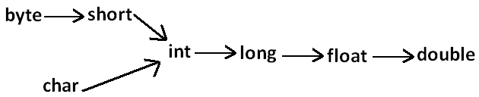
The main advantage of this approach is readability of the code will be improved At the time of compilation ' _ ' symbols will be removed automatically , hence after
compilation the above lines will become double d = 123456.789
We can use more than one underscore symbol also between the digits.
Ex : double d = 1_23_ _456.789;
We should use underscore symbol only between the digits
double d=_1_23_456.7_8_9; //invalid
double d=1_23_456.7_8_9_; //invalid
double d=1_23_456_.7_8_9; //invalid
double d='a';
System.out.println(d); //97
integral data types
float f=10L;
System.out.println(f); //10.0
floating-point data types

Slide 37
Arrays
1) Introduction
2) Array declaration
3) Array construction
4) Array initialization
5) Array declaration, construction, initialization in a single line.
6) length Vs length() method
7) Anonymous arrays
8) Array element assignments
9) Array variable assignments.

Slide 38
Introduction
An array is an indexed collection of fixed number of homogeneous data elements.
The main advantage of arrays is we can represent multiple values with the same name so that readability of the code will be improved.
But the main disadvantage of arrays is:
Fixed in size that is once we created an array there is no chance of increasing or
decreasing the size based on our requirement that is to use arrays concept compulsory
we should know the size in advance which may not possible always
We can resolve this problem by using collections.
Array declarations:
Single dimensional array declaration:
Example:
int[] a;//recommended to use because name is clearly separated from the
type
int []a;
int a[];
At the time of declaration we can't specify the size otherwise we will get compile time error.

Slide 39
Three dimensional array declaration:
Example:
int[][][] a;
int [][][]a;
int a[][][];
int[] [][]a;
int[] a[][]; All are valid.(10 ways)
int[] []a[];
int[][] []a;
int[][] a[];
int []a[][];
int [][]a[];
Example:
int[] a;//valid
int[5] a;//invalid
Two dimensional array declaration:
Example:
int[][] a;
int [][]a;
int a[][]; All are valid.(6 ways)
int[] []a;
int[] a[];
int []a[];
Which of the following declarations are valid?
1) int[] a1,b1; //a-1,b-1 (valid)
2) int[] a2[],b2; //a-2,b-1 (valid)
3) int[] []a3,b3; //a-2,b-2 (valid)
4) int[] a,[]b; //C.E: expected (invalid)
19

Slide 40
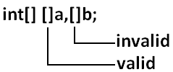
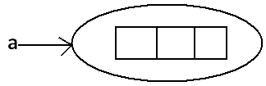
Note :
If we want to specify the dimension before the variable that rule is applicable only for the 1st variable.
Second variable onwards we can't apply in the same declaration.
Example:
For every array type corresponding classes are available but these classes are part of
java language and not available to the programmer level.
Array construction:
Every array in java is an object hence we can create by using new operator.
Example:
int[] a=new int[3];
20

Slide 41
Array Type | corresponding class name
int[] | [I
int[][] | [[I
double[] | [D
Rule 1:
At the time of array creation compulsory we should specify the size otherwise we will
get compile time error.
Rule 2:
It is legal to have an array with size zero in java.
Example:
int[] a=new int[3];
int[] a=new int[];//C.E:array dimension missing
Example:
int[] a=new int[0];
System.out.println(a.length);//0
Rule 3:
If we are taking array size with -ve int value then we will get runtime exception saying
NegativeArraySizeException.
Example:
int[] a=new int[-3];//R.E:NegativeArraySizeException

Slide 42
Rule 4:
The allowed data types to specify array size are byte, short, char, int.
By mistake if we are using any other type we will get compile time error.
Example:
int[] a=new int['a'];//(valid)
byte b=10;
int[] a=new int[b];//(valid)
short s=20;
int[] a=new int[s];//(valid)
int[] a=new int[10l];//C.E:possible loss of precision//(invalid)
int[] a=new int[10.5];//C.E:possible loss of precision//(invalid)
Example:
int[] a1=new int[2147483647];(valid)
int[] a2=new int[2147483648];
//C.E:integer number too large: 2147483648(invalid)
Rule 5:
The maximum allowed array size in java is maximum value of int size [2147483647].
In the first case we may get RE : OutOfMemoryError.

Slide 43
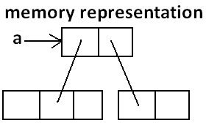
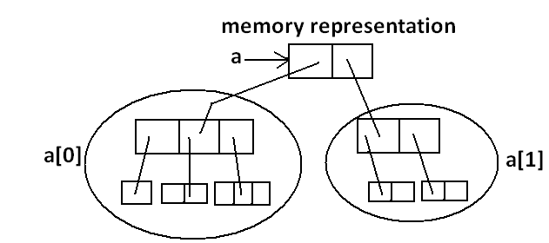
Multi dimensional array creation:
In java multidimensional arrays are implemented as array of arrays approach but not
matrix form.
The main advantage of this approach is to improve memory utilization.
Example 1:
int[][] a=new int[2][];
a[0]=new int[3];
a[1]=new int[2];
Example 2:
int[][][] a=new int[2][][];
a[0]=new int[3][];
a[0][0]=new int[1];
a[0][1]=new int[2];
a[0][2]=new int[3];
a[1]=new int[2][2];

Slide 44
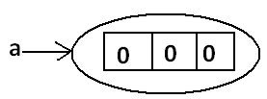
Which of the following declarations are valid?
1) int[] a=new int[]//C.E: array dimension missing(invalid)
2) int[][] a=new int[3][4];(valid)
3) int[][] a=new int[3][];(valid)
4) int[][] a=new int[][4];//C.E:']' expected(invalid)
5) int[][][] a=new int[3][4][5];(valid)
6) int[][][] a=new int[3][4][];(valid)
7) int[][][] a=new int[3][][5];//C.E:']' expected(invalid)
Array Initialization:
Whenever we are creating an array every element is initialized with default value
automatically.
Note: Whenever we are trying to print any object reference internally toString() method
will be executed which is implemented by default to return the following.
classname@hexadecimalstringrepresentationofhashcode.
Example 1:
int[] a=new int[3];
System.out.println(a);//[I@3e25a5
System.out.println(a[0]);//0

Slide 45
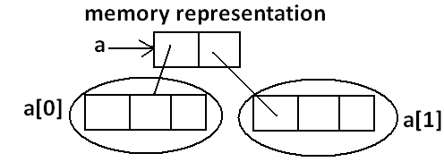

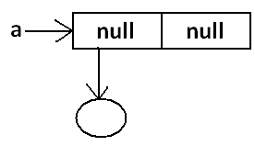
Example 2:
System.out.println(a);//[[I@3e25a5
System.out.println(a[0]);//[I@19821f
System.out.println(a[0][0]);//0
Example 3:
int[][] a=new int[2][];
System.out.println(a);//[[I@3e25a5
System.out.println(a[0]);//null
System.out.println(a[0][0]);//R.E:NullPointerException
Once we created an array all its elements by default initialized with default values.
If we are not satisfied with those default values then we can replays with our customized
values.

Slide 46
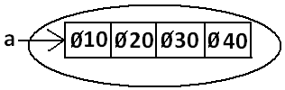
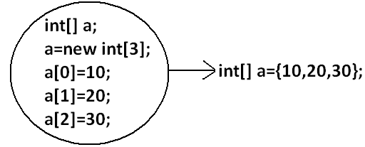
Example:
int[] a=new int[4];
a[0]=10;
a[1]=20;
a[2]=30;
a[3]=40;
a[4]=50;//R.E:ArrayIndexOutOfBoundsException: 4
a[-4]=60;//R.E:ArrayIndexOutOfBoundsException: -4
Note: if we are trying to access array element with out of range index we will get
Runtime Exception saying ArrayIndexOutOfBoundsException.
Declaration, construction and initialization of an array in a single line:
We can perform declaration, construction and initialization of an array in a single line.

Slide 47
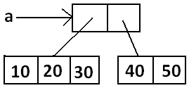
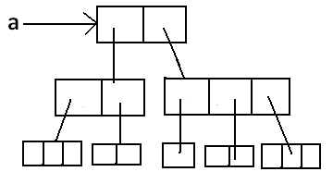
char[] ch={'a','e','i','o','u'};(valid)
String[] s={"balayya","venki","nag","chiru"};(valid)
We can extend this short cut even for multi dimensional arrays also.
Example:
int[][] a={{10,20,30},{40,50}};
Example:
int[][][] a={{{10,20,30},{40,50}},{{60},{70,80},{90,100,110}}};
int[][][] a={{{10,20,30},{40,50}},{{60},{70,80},{90,100,110}}};
System.out.println(a[0][1][1]);//50(valid)
System.out.println(a[1][0][2]);//R.E:ArrayIndexOutOfBoundsException:
2(invalid)

Slide 48
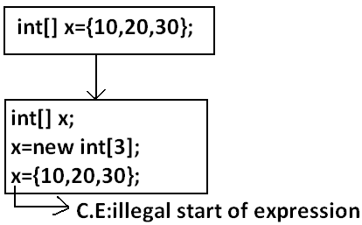
System.out.println(a[1][2][1]);//100(valid)
System.out.println(a[1][2][2]);//110(valid)
System.out.println(a[2][1][0]);//R.E:ArrayIndexOutOfBoundsException:
2(invalid)
System.out.println(a[1][1][1]);//80(valid)
• If we want to use this short cut compulsory we should perform declaration,
construction and initialization in a single line.
• If we are trying to divide into multiple lines then we will get compile time error

Slide 49
length Vs length():
length:
1. It is the final variable applicable only for arrays.
2. It represents the size of the array.
Example:
int[] x=new int[3];
System.out.println(x.length());//C.E: cannot find symbol
System.out.println(x.length);//3
length() method:
1. It is a final method applicable for String objects.
2. It returns the no of characters present in the String.
Example:
String s="bhaskar";
System.out.println(s.length);//C.E:cannot find symbol
System.out.println(s.length());//7

Slide 50
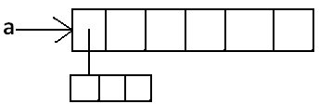
In multidimensional arrays length variable represents only base size but not total size.
Example:
int[][] a=new int[6][3];
System.out.println(a.length);//6
System.out.println(a[0].length);//3
length variable applicable only for arrays where as length()method is applicable for
String objects.
There is no direct way to find total size of multi dimentional array but indirectly we can
find as follows
x[o].length +x[1].length + x[2].length + .......

Slide 51
Anonymous Arrays:
• Sometimes we can create an array without name such type of nameless arrays
are called anonymous arrays.
• The main objective of anonymous arrays is "just for instant use".
• We can create anonymous array as follows.
• new int[]{10,20,30,40};(valid)
• new int[][]{{10,20},{30,40}};(valid)
• At the time of anonymous array creation we can't specify the size otherwise we
will get compile time error.
Example:
new int[3]{10,20,30,40};//C.E:';' expected(invalid)
new int[]{10,20,30,40};(valid)
Based on our programming requirement we can give the name for anonymous array
then it is no longer anonymous.
Example:
int[] a=new int[]{10,20,30,40};(valid)

Slide 52
Example:
class Test
{
public static void main(String[] args)
{
System.out.println(sum(new int[]{10,20,30,40}));//100
}
public static int sum(int[] x)
{
int total=0;
for(int x1:x)
{
total=total+x1;
}
return total;
}
}
In the above program just to call sum() , we required an array but after completing
sum() call we are not using that array any more, ananimous array is best suitable.

Slide 53
Array element assignments:

Slide 54
In the case of primitive array as array element any type is allowed which can be
promoted to declared type.
Example 1:
For the int type arrays the allowed array element types are byte, short, char, int.
int[] a=new int[10];
a[0]=97;//(valid)
a[1]='a';//(valid)
byte b=10;
a[2]=b;//(valid)
short s=20;
a[3]=s;//(valid)
a[4]=10l;//C.E:possible loss of precision
Example 2:
For float type arrays the allowed element types are byte, short, char, int, long, float

Slide 55
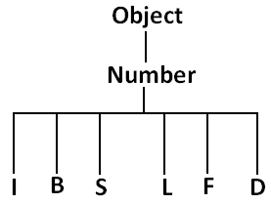
Case 2:
In the case of Object type arrays as array elements we can provide either declared type
objects or its child class objects.
Example 1:
Object[] a=new Object[10];
a[0]=new Integer(10);//(valid)
a[1]=new Object();//(valid)
a[2]=new String("bhaskar");//(valid)
Example 2:
Number[] n=new Number[10];
n[0]=new Integer(10);//(valid)
n[1]=new Double(10.5);//(valid)
n[2]=new String("bhaskar");//C.E:incompatible types//(invalid)
Example:
Runnable[] r=new Runnable[10];
r[0]=new Thread();
r[1]=new String("bhaskar");//C.E: incompatible types
Case 3:
In the case of interface type arrays as array elements we can provide its implemented
class objects.

Slide 56
Array Type | Allowed Element Type
1) Primitive arrays. | 1) Any type which can be promoted to declared type.
2) Object type arrays. | 2) Either declared type or its child class objects allowed.
3) Interface type arrays. | 3) Its implemented class objects allowed.
4) Abstract class type arrays. | 4) Its child class objects are allowed.
Array variable assignments:
Case 1:
• Element level promotions are not applicable at array object level.
• Ex : A char value can be promoted to int type but char array cannot be
promoted to int array.
Example:
int[] a={10,20,30};
char[] ch={'a','b','c'};
int[] b=a;//(valid)
int[] c=ch;//C.E:incompatible types(invalid)

Slide 57
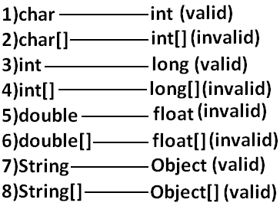
Which of the following promotions are valid?
Note: In the case of object type arrays child type array can be assign to parent type
array variable.
Example:
String[] s={"A","B"};
Object[] o=s;

Slide 58
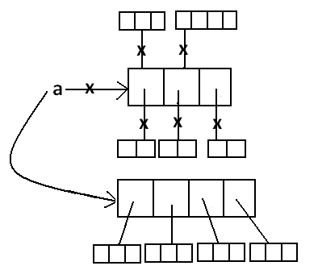
Case 2:
Whenever we are assigning one array to another array internal elements won't be copy
just reference variables will be reassigned hence sizes are not important but types must
be matched.
Example:
int[] a={10,20,30,40,50,60,70};
int[] b={80,90};
a=b;//(valid)
b=a;//(valid)
S
W
Total how many objects created?
Ans: 11
How many objects eligible for GC: 6
O
T
Example 2:
class Test
{
public static void main(String[] args)
{
String[] argh={"A","B"};
args=argh;
System.out.println(args.length);//2

Slide 59
for(int i=0;i<=args.length;i++)
{
System.out.println(args[i]);
}
}
}
Output:
java Test x y
R.E: ArrayIndexOutOfBoundsException: 2
java Test x
R.E: ArrayIndexOutOfBoundsException: 2
java Test
R.E: ArrayIndexOutOfBoundsException: 2
Note: Replace with i<args.length
Example 3:
class Test
{
public static void main(String[] args)
{
String[] argh={"A","B"};
args=argh;
System.out.println(args.length);//2
for(int i=0;i<args.length;i++)
{
System.out.println(args[i]);
}
}
}
Output:
2
A
B

Slide 60
Example 4:
class Test
{
public static void main(String[] args)
{
String[] argh={"A","B"};
args=argh;
for(String s : args) {
System.out.println(s);
}
}
Output:
A
B
Types of Variables
Division 1 : Based on the type of value represented by a variable all variables are
divided into 2 types. They are:
1. Primitive variables
2. Reference variables

Slide 61

Primitive variables:
Primitive variables can be used to represent primitive values.
Example: int x=10;
Reference variables:
Reference variables can be used to refer objects.
Example: Student s=new Student();
Division 2 : Based on the behaviour and position of declaration, all variables are divided
into the following 3 types.
1. Instance variables
2. Static variables
3. Local variables

Slide 62
Instance variables:
• If the value of a variable is varied from object to object such type of variables are
called instance variables.
• For every object a separate copy of instance variables will be created.
• Instance variables will be created at the time of object creation and destroyed at
the time of object destruction hence the scope of instance variables is exactly
same as scope of objects.
• Instance variables will be stored on the heap as the part of object.
• Instance variables should be declared with in the class directly but outside of any
method or block or constructor.
• Instance variables can be accessed directly from Instance area. But cannot be
accessed directly from static area.
• But by using object reference we can access instance variables from static area.

Slide 63
Example:
class Test
{
int i=10;
public static void main(String[] args)
{
//System.out.println(i);
//C.E:non-static variable i cannot be referenced from a static
context(invalid)
Test t=new Test();
System.out.println(t.i);//10(valid)
t.methodOne();
}
public void methodOne()
{
System.out.println(i);//10(valid)
}
}

Slide 64
Instance variables also known as object level variables or attributes.
Static variables:
• If the value of a variable is not varied from object to object such type of variables
is not recommended to declare as instance variables. We have to declare such
type of variables at class level by using static modifier.
• In the case of instance variables for every object a separate copy will be created
but in the case of static variables for entire class only one copy will be created
and shared by every object of that class.
• Static variables will be crated at the time of class loading and destroyed at the
time of class unloading hence the scope of the static variable is exactly same as
the scope of the .class file.
• Static variables will be stored in method area. Static variables should be declared
with in the class directly but outside of any method or block or constructor.
• Static variables can be accessed from both instance and static areas directly.
• We can access static variables either by class name or by object reference but
usage of class name is recommended.
• But within the same class it is not required to use class name we can access
directly.

Slide 65
java TEST
1. Start JVM.
2. Create and start Main Thread by JVM.
3. Locate(find) Test.class by main Thread.
4. Load Test.class by main Thread. // static variable creation
5. Execution of main() method.
6. Unload Test.class // static variable destruction
7. Terminate main Thread.
8. Shutdown JVM.
Example:
class Test
{
static int i=10;
public static void main(String[] args)
{
Test t=new Test();
System.out.println(t.i);//10
System.out.println(Test.i);//10
System.out.println(i);//10
}
}
For the static variables it is not required to perform initialization explicitly, JVM will
always provide default values.
Example:
class Test
{
static String s;
public static void main(String[] args)
{
System.out.println(s);//null
}
}

Slide 66
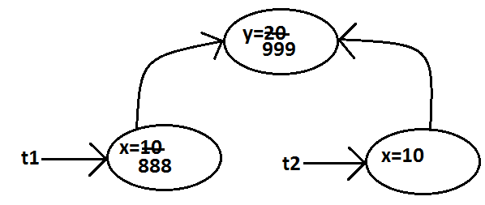
Example:
class Test
{
int x=10;
static int y=20;
public static void main(String[] args)
{
Test t1=new Test();
t1.x=888;
t1.y=999;
Test t2=new Test();
System.out.println(t2.x+"----"+t2.y);//10----999

Slide 67
Static variables also known as class level variables or fields.
Local variables:
Some times to meet temporary requirements of the programmer we can declare
variables inside a method or block or constructors such type of variables are called local
variables or automatic variables or temporary variables or stack variables
Local variables will be stored inside stack.
The local variables will be created as part of the block execution in which it is declared
and destroyed once that block execution completes. Hence the scope of the local
variables is exactly same as scope of the block in which we declared.
Example 1:
class Test
{
public static void main(String[] args)
{
int i=0;
for(int j=0;j<3;j++)
{
i=i+j;
}
}
}

Slide 68
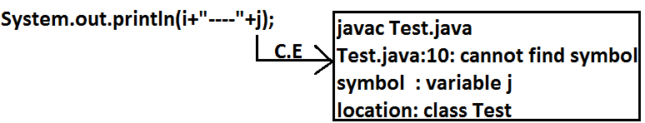
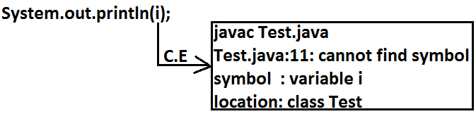
Example 2:
class Test
{
public static void main(String[] args)
{
try
{
int i=Integer.parseInt("ten");
}
catch(NullPointerException e)
{
}
}
}
• The local variables will be stored on the stack.
• For the local variables JVM won't provide any default values compulsory we
should perform initialization explicitly before using that variable.

Slide 69
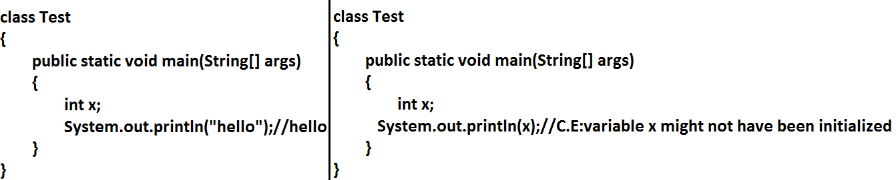
Example:
class Test
{
public static void main(String[] args)
{
int x;
if(args.length>0)
{
x=10;
}
System.out.println(x);
//C.E:variable x might not have been initialized
}
}

Slide 70
Example:
class Test
{
public static void main(String[] args)
{
int x;
if(args.length>0)
{
x=10;
}
else
{
x=20;
}
System.out.println(x);
}
}
Output:
java Test x
10
java Test x y
10
java Test
20
It is never recommended to perform initialization for the local variables inside
logical blocks because there is no guarantee of executing that block always at
runtime.
• It is highly recommended to perform initialization for the local variables at the
time of declaration at least with default values.
Note: The only applicable modifier for local variables is final. If we are using any other
modifier we will get compile time error.

Slide 71
Example:
class Test
{
public static void main(String[] args)
{
public int x=10; //(invalid)
private int x=10; //(invalid)
protected int x=10; //(invalid) C.E: illegal start of
expression
static int x=10; //(invalid)
volatile int x=10; //(invalid)
transient int x=10; //(invalid)
final int x=10;//(valid)
}
}
Conclusions:
1. For the static and instance variables it is not required to perform initialization
explicitly JVM will provide default values. But for the local variables JVM won't provide any default values compulsory we should perform initialization explicitly
before using that variable.

Slide 72
2. For every object a separate copy of instance variable will be created whereas for
entire class a single copy of static variable will be created. For every Thread a
separate copy of local variable will be created.
3. Instance and static variables can be accessed by multiple Threads simultaneously
and hence these are not Thread safe but local variables can be accessed by only
one Thread at a time and hence local variables are Thread safe.
4. If we are not declaring any modifier explicitly then it means default modifier but
this rule is applicable only for static and instance variables but not local variable.

Slide 73
Un Initialized arrays

Slide 74
Example:
class Test
{
int[] a;
public static void main(String[] args)
{
Test t1=new Test();
System.out.println(t1.a);//null
System.out.println(t1.a[0]);//R.E:NullPointerException
}
}
Instance level:
Example 1:
int[] a;
System.out.println(obj.a);//null
System.out.println(obj.a[0]);//R.E:NullPointerException
Example 2:
int[] a=new int[3];
System.out.println(obj.a);//[I@3e25a5
System.out.println(obj.a[0]);//0

Slide 75
Static level:
Example 1:
static int[] a;
System.out.println(a);//null
System.out.println(a[0]);//R.E:NullPointerException
Example 2:
static int[] a=new int[3];
System.out.println(a);//[I@3e25a5
System.out.println(a[0]);//0
Local level:
Example 1:
int[] a;
System.out.println(a); //C.E: variable a might not have been initialized
System.out.println(a[0]);
Example 2:
int[] a=new int[3];
System.out.println(a);//[I@3e25a5
System.out.println(a[0]);//0
Once we created an array every element is always initialized with default values
irrespective of whether it is static or instance or local array.
Every variable in java should be either instance or static or local.
Every variable in java should be either primitive or reference

Slide 76
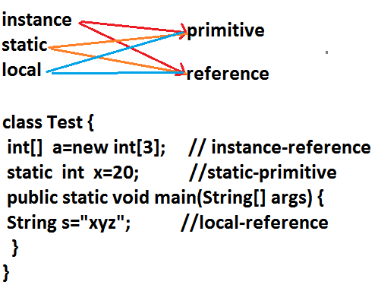
Hence the following are the various possible combinations for variables
Var- arg methods (variable no of argument methods) (1.5)
• Until 1.4v we can't declared a method with variable no. Of arguments.
• If there is a change in no of arguments compulsory we have to define a new
method.
• This approach increases length of the code and reduces readability.
• But from 1.5 version onwards we can declare a method with variable no. Of
arguments such type of methods are called var-arg methods.

Slide 77

We can declare a var-arg method as follows.
{
methodOne();
methodOne(10);
methodOne(10,20,30);
}
}
Output:
var-arg method
var-arg method
var-arg method
We can call or invoke this method by passing any no. Of int values including zero
number also.
Example:
class Test
{
public static void methodOne(int... x)
{
System.out.println("var-arg method");
}
public static void main(String[] args)
{
methodOne();
Internally var-arg parameter implemented by using single dimensional array hence
within the var-arg method we can differentiate arguments by using index.

Slide 78
Example:
class Test
{
public static void sum(int... x)
{
int total=0;
for(int i=0;i<x.length;i++)
{
total=total+x[i];
}
System.out.println("The sum :"+total);
}
public static void main(String[] args)
{
sum();
sum(10);
sum(10,20);
sum(10,20,30,40);
}
}
Output:
The sum: 0
The sum: 10
The sum: 30
The sum: 100

Slide 79
Example:
class Test
{
public static void sum(int... x)
{
int total=0;
for(int x1 : x)
{
total=total+x1;
}
System.out.println("The sum :"+total);
}
public static void main(String[] args)
{
sum();
sum(10);
sum(10,20);
sum(10,20,30,40);
}
}
Output:
The sum: 0
The sum: 10
The sum: 30
The sum: 100
Case 1:
Which of the following var-arg method declarations are valid?
1. methodOne(int... x) (valid)
2. methodOne(int ...x) (valid)
3. methodOne(int...x) (valid)
4. methodOne(int x...) (invalid)
5. methodOne(int. ..x) (invalid)
6. methodOne(int .x..) (invalid)

Slide 80
Case 2:
We can mix var-arg parameter with general parameters also.
Example:
methodOne(int a,int... b) //valid
methodOne(String s,int... x) //valid
Case 3:
if we mix var-arg parameter with general parameter then var-arg parameter should be
Case 4:
With in the var-arg method we can take only one var-arg parameter. i.e., if we are
trying to more than one var-arg parameter we will get CE.
the last parameter.
Example:
methodOne(int a,int... b) //valid
methodOne(int... a,int b) //(invalid)

Slide 81

In general var-arg method will get least priority that is if no other method matched then
only var-arg method will get the chance this is exactly same as default case inside a
switch.
Example:
methodOne(int... a,int... b) //(invalid)
Case 5:
class Test
{
public static void methodOne(int i)
{
System.out.println("general method");
}
public static void methodOne(int... i)
{
System.out.println("var-arg method");
}
public static void main(String[] args)
{
methodOne();//var-arg method
methodOne(10,20);//var-arg method
methodOne(10);//general method
}
}
Case 6:
For the var-arg methods we can provide the corresponding type array as argument.
Example:
class Test
{
{
System.out.println("var-arg method");
}
public static void main(String[] args)
{
methodOne(new int[]{10,20,30});//var-arg method
}
}

Slide 82
Case 7:
class Test
{
public void methodOne(int[] i){}
Example:
methodOne(int... a,int... b) //(invalid)
the last parameter.
Example:
methodOne(int a,int... b) //valid
methodOne(int... a,int b) //(invalid)
Case 4:
With in the var-arg method we can take only one var-arg parameter. i.e., if we are
trying to more than one var-arg parameter we will get CE.

Slide 83
In general var-arg method will get least priority that is if no other method matched then
only var-arg method will get the chance this is exactly same as default case inside a
switch.
Case 5:
class Test
{
public static void methodOne(int i)
{
System.out.println("general method");
}
public static void methodOne(int... i)
{
System.out.println("var-arg method");
}
public static void main(String[] args)
{
methodOne();//var-arg method
methodOne(10,20);//var-arg method
methodOne(10);//general method
}
}

Slide 84
Case 6:
For the var-arg methods we can provide the corresponding type array as argument.
Example:
class Test
{
System.out.println("var-arg method");
}
public static void main(String[] args)
{
methodOne(new int[]{10,20,30});//var-arg method
}
}

Slide 85

Case 7:
class Test
{
public void methodOne(int[] i){}
public void methodOne(int... i){}
}
Output:
Compile time error.
Cannot declare both methodOne(int...) and methodOne(int[]) in Test
Single Dimensional Array Vs Var-Arg Method:
Case 1:
Wherever single dimensional array present we can replace with var-arg parameter

Slide 86
Example:
class Test
{
public static void main(String... args)
{
System.out.println("var-arg main method");//var-arg main
method
}
}
Case 2:
Wherever var-arg parameter present we can't replace with single dimensional array

Slide 87
Note :
1. methodOne(int... x)
we can call this method by passing a group of int values and x will become 1D
array. (i.e., int[] x)
2. methodOne(int[]... x)
we can call this method by passing a group of 1D int[] and x will become 2D
array. ( i.e., int[][] x)
Above reasons this case 2 is invalid.
}
}
public static void main(String[] args)
{
int[] l={10,20,30};
int[] m={40,50};
methodOne(l,m);
}
}
Output:
10
40
Example:
class Test
{
public static void methodOne(int[]... x)
{
for(int[] a:x)
{
System.out.println(a[0]);

Slide 88

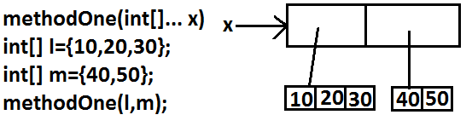
Analysis:

Slide 89
Main Method

Slide 90
Whether the class contains main() method or not,
and whether it is properly declared or not,
these checking's are not responsibilities of the compiler, at runtime JVM is responsible
for this.
If JVM unable to find the required main() method then we will get runtime exception
saying NoSuchMethodError: main.
Example:
class Test
{}
Output:
javac Test.java
java Test R.E: NoSuchMethodError: main

Slide 91
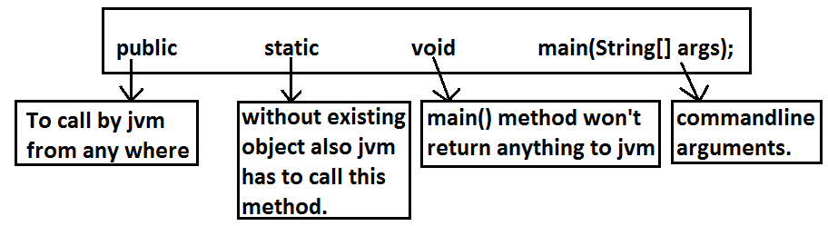
At runtime JVM always searches for the main() method with the following prototype.
If we are performing any changes to the above syntax then the code won't run and will
get Runtime exception saying NoSuchMethodError.

Slide 92
Even though above syntax is very strict but the following changes are acceptable to
main() method.
1. The order of modifiers is not important that is instead of public static we can
take static public.
2. We can declare string[] in any acceptable form
o String[] args
o String []args
o String args[]
3. Instead of args we can use any valid java identifier.
4. We can replace string[] with var-arg parameter.
Example: main(String... args)
5. main() method can be declared with the following modifiers.
final, synchronized, strictfp.
6. class Test {
7. static final syncronized strictfp public void main(String... ask){
8. System.out.println("valid main method");
9. }
10. }
11. output :
12. valid main method

Slide 93
Which of the following main() method declarations are valid ?
1. public static void main(String args){} (invalid)
2. public synchronized final strictfp void main(String[] args){} (invalid)
3. public static void Main(String... args){} (invalid)
4. public static int main(String[] args){} //int return type we can't take //(invalid)
5. public static synchronized final strictfp void main(String... args){}(valid)
6. public static void main(String... args){}(valid)
7. public void main(String[] args){}(invalid)
In which of the above cases we will get compile time error ?
No case, in all the cases we will get runtime exception

Slide 94
Case 1 :
Overloading of the main() method is possible but JVM always calls string[] argument
main() method only
class Test
{
public static void main(String[] args)
{
System.out.println("String[] array main method"); //overloaded
methods
}
public static void main(int[] args)
{
System.out.println("int[] array main method");
}
}
Output:
String[] array main method

Slide 95
The other overloaded method we have to call explicitly then only it will be executed.
Case 2:
Inheritance concept is applicable for static methods including main() method
hence while executing child class if the child class doesn't contain main() method then
the parent class main() method will be executed.
Example 1:
class Parent
{
public static void main(String[] args)
{
System.out.println("parent main"); //Parent.java
}
}
class Child extends Parent
{}

Slide 96
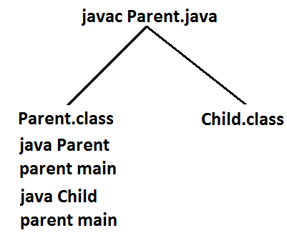
Analysis:
class Child extends Parent
{
public static void main(String[] args)
{
System.out.println("Child main");
}
}
Example 2:
class Parent
{
public static void main(String[] args)
{
System.out.println("parent main"); // Parent.java
}
}

Slide 97
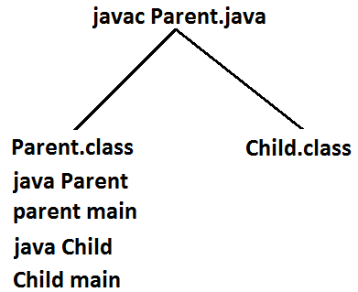
Analysis:
It seems to be overriding concept is applicable for static methods but it is not overriding
it is method hiding.

Slide 98
Version Enhansements with respect to main()

Slide 99
Case 1 :
• Untill 1.6v if our class doesn't contain main() method then at runtime we will get
Runtime Exception saying NosuchMethodError:main
• But from 1.7 version onwards instead of NoSuchMethodError we will get more
meaning full description
1.7 version :
javac Test.java
java Test
Error: main method not found in class Test, please define the main method
as
public static void main(String[] args)
class Test {
}
1.6 version :
javac Test.java
java Test
RE: NoSuchMethodError:main

Slide 100
Case 2 :
From 1.7 version onwards to start program execution compulsory main method should
be required, hence even though the class contains static block if main method not
available then won't be executed
class Test {
static {
System.out.println("static block");
}
}
1.7 version :
javac Test.java
java Test
Error: main method not found in class Test, please define the main method
as
public static void main(String[] args)
1.6 version :
javac Test.java
java Test
output :
static block
RE: NoSuchMethodError:main

Slide 101
Case 4 :
class Test {
static {
System.out.println("static block");
}
public static void main(String[] args) {
System.out.println("main method");
}
}
1.6 version
javac Test.java
java Test
Case 3 :
class Test {
static {
System.out.println("static block");
System.exit(0);
}
}
1.6 version :
javac Test.java
java Test
output :
static block
output :
static block
main method
1.7 version :
javac Test.java
java Test
Error: main method not found in class Test, please define the main method
as
public static void main(String[] args)
1.7 version :
javac Test.java
java Test
output :
static block
main method

Slide 102
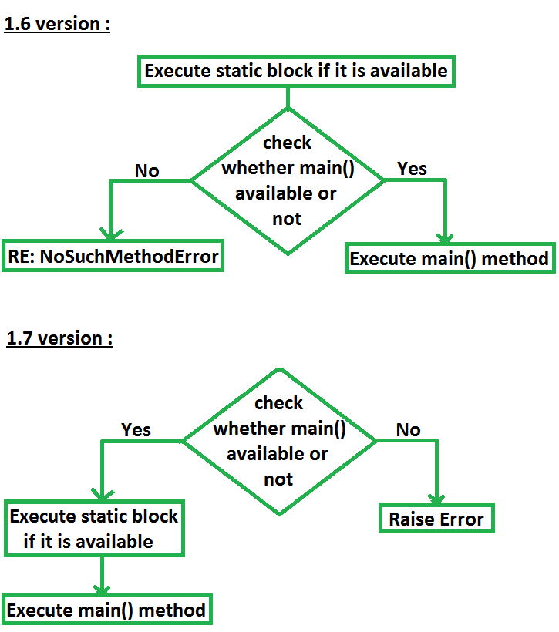

Slide 103
Command line arguments:

Slide 104
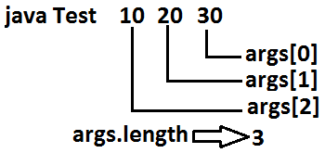
The arguments which are passing from command prompt are called command line
arguments.
The main objective of command line arguments are we can customize the behavior of
the main() method.
Example 1:
class Test
{
public static void main(String[] args)
{
for(int i=0;i<=args.length;i++)
{
System.out.println(args[i]);
}
}
}
Output:
java Test x y z
ArrayIndexOutOfBoundsException: 3
Replace i<=args.length with i<args.length then it will run successfully

Slide 105
Output:
java Test A B C
X
Y
Z
java Test A B
X
Y
Z
java Test
X
Y
Z
Example 2 :
class Test
{
public static void main(String[] args)
{
String[] argh={"X","Y","Z"};
args=argh;
for(String s : args)
{
System.out.println(s);
}
}
}

Slide 106
Within the main() method command line arguments are available in the form of String
hence "+" operator acts as string concatenation but not arithmetic addition
Example 3 :
class Test
{
public static void main(String[] args)
{
System.out.println(args[0]+args[1]);
}
}
Output:
E:\SCJP>javac Test.java
E:\SCJP>java Test 10 20
1020

Slide 107
Space is the separator between 2 command line arguments and if our command line
argument itself contains space then we should enclose with in double quotes.
Example 4 :
class Test
{
public static void main(String[] args)
{
System.out.println(args[0]);
}
}
Output:
E:\SCJP>javac Test.java
E:\SCJP>java Test "Sai Charan"
Sai Charan

Slide 108
Java coding standards

Slide 109
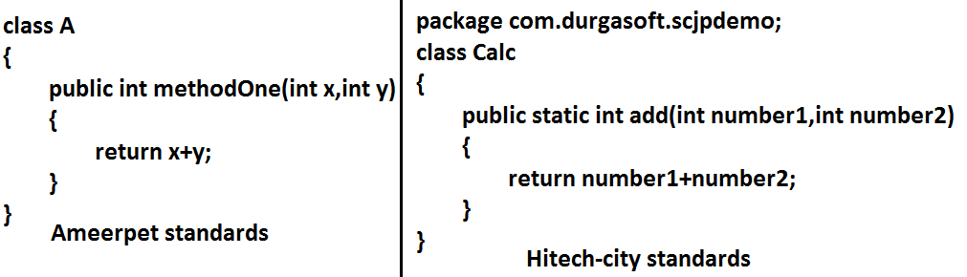
• Whenever we are writing java code , It is highly recommended to follow coding
standards , which improves the readability and understandability of the code.
• Whenever we are writing any component(i.e., class or method or variable) the
name of the component should reflect the purpose or functionality

Slide 110
Coding standards for classes:
• Usually class names are nouns.
• Should starts with uppercase letter and if it contains multiple words every inner
word should starts with upper case letter.
Coding standards for interfaces:
• Usually interface names are adjectives.
• Should starts with upper case letter and if it contains multiple words every inner
word should starts with upper case letter.

Slide 111
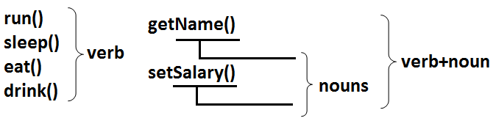
Example:
1. Serializable
2. Runnable
3. Cloneable
these are adjectives
Coding standards for methods:
• Usually method names are either verbs or verb-noun combination.
• Should starts with lowercase character and if it contains multiple words ev

Slide 112
Coding standards for variables:
• Usually variable names are nouns.
• Should starts with lowercase alphabet symbol and if it contains multiple words
every inner word should starts with upper case character.(camel case
convention)
Example:
length
name
salary nouns
age
mobileNumber
Coding standards for constants:
• Usually constants are nouns.
• Should contain only uppercase characters and if it contains multiple words then
these words are separated with underscore symbol.
• Usually we can declare constants by using public static final modifiers

Slide 113
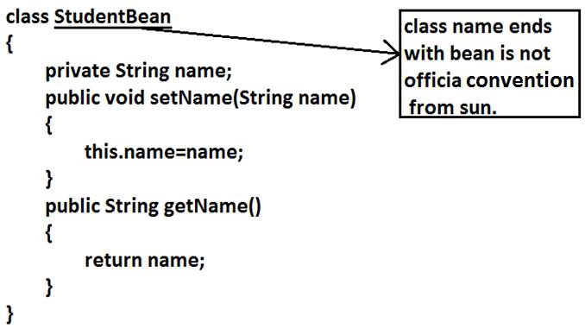
Example:
MAX_VALUE
MIN_VALUE nouns
NORM_PRIORITY
Java bean coding standards:
A java bean is a simple java class with private properties and public getter and setter
methods.
Example:

Slide 114
Syntax for setter method:
1. Method name should be prefixed with set.
2. It should be public.
3. Return type should be void.
4. Compulsory it should take some argument.
Syntax for getter method:
1. The method name should be prefixed with get.
2. It should be public.
3. Return type should not be void.
4. It is always no argument method.

Slide 115
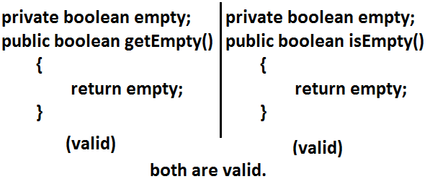
Note: For the boolean properties the getter method can be prefixed with either get or is.
But recommended to use is

Slide 116
Coding standards for listeners:

Slide 117
To register a listener:
Method name should be prefixed with add.
1. public void addMyActionListener(MyActionListener l) (valid)
2. public void registerMyActionListener(MyActionListener l) (invalid)
3. public void addMyActionListener(ActionListener l) (invalid)
To unregister a listener:
The method name should be prefixed with remove.
1. public void removeMyActionListener(MyActionListener l) (valid)
2. publc void unregisterMyActionListener(MyActionListener l) (invalid)
3. public void removeMyActionListener(ActionListener l) (invalid)
4. public void deleteMyActionListener(MyActionListener l) (invalid)

Slide 118
Various Memory areas present inside JVM

Slide 119
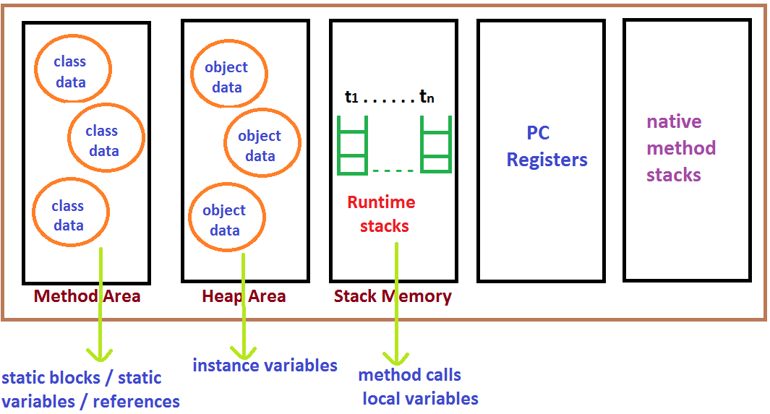

Slide 120
1. Class level binary data including static variables will be stored in method area.
2. Objects and corresponding instance variables will be stored in Heap area.
3. For every method the JVM will create a Runtime stack all method calls
performed by that Thread and corresponding local variables will be stored in
that stack.
Every entry in stack is called Stack Frame or Action Record.
4. The instruction which has to execute next will be stored in the corresponding PC
Registers.
5. Native method invocations will be stored in native method stacks.

Slide 121


